Slide 1
Welcome to Steele strong

Slide 2
Our SPLIT routines
3 Days Week | j
Monday Wednesday Friday
Chest Back Legs
Triceps Biceps Glutes
Shoulders Abs/Core Abs/Core
Abs/Core
Abs/Core and Cardio on Extra Days
2 Days Week | Back/Biceps Legs Chest/ Shoulders Glutes Triceps/ Abs/Core Abs/Core
Tuesday Thursday
1 Day Week | Legs Glutes Back Chest Triceps Biceps Shoulders Abs/Core
Saturday

Slide 3
Our Exercise program
Warm-Up | Strength | Weight Training | Abs/Core | Cardio
5 Min | 5 Min | 25 Min | 5 Min | 20 Min
1 Hour- Fun, Fast, and Effective

Slide 4
Pyramid of Success
Cardio
Weight Training
Nutrition

Slide 5
Our Nutrition Program Science based meal plan individualized to each client
Caloric Intake
(how much)
Ratio
Macronutrients
(what)
Meal Frequency
(when)
Supplementation
(Vitamins & Minerals)

Slide 6
Accountability AND motivation
Food
Journaling
Events
High
Energy
Monthly
Fitness
Profiles
Service
Calls
Constant
Change
Team

Slide 7
The program
Proper
Nutrition
Results
(Success Stories)
Proper
Exercise

Slide 8
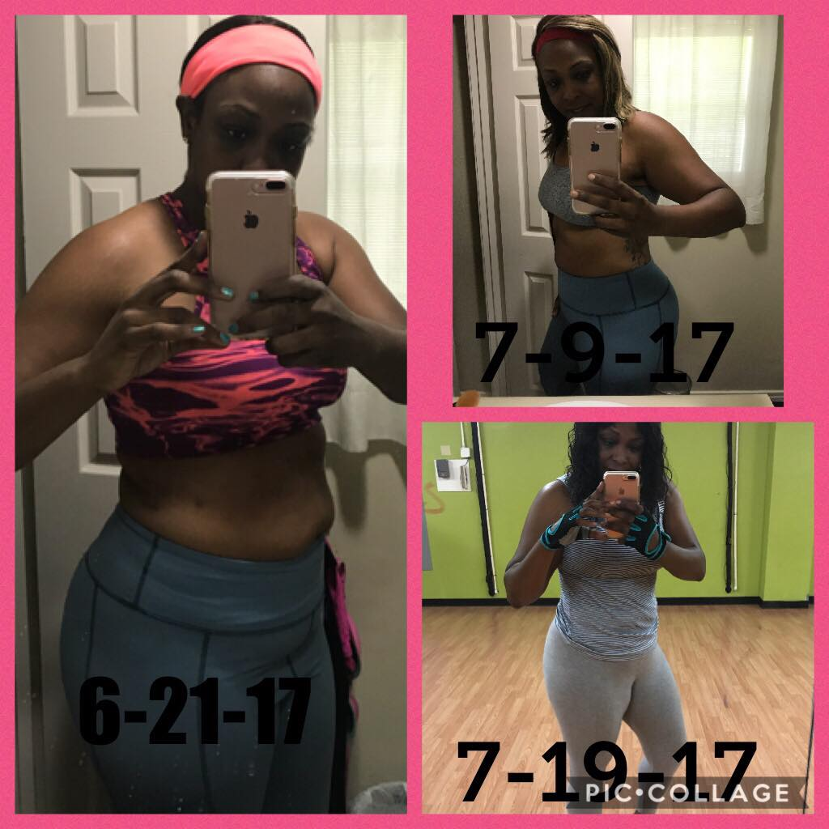
Angela Purnell Success Stories
On June 20, 2017, I decided I was ready to make the first step at achieving my goal of becoming healthier and physically fit to my desire. This was not my first rodeo, I've done many fit programs and gained results, but my drive and determination was gone. Over the last year and a half, I've watched Latoya challenge herself and train herself with working out and eating healthy. Her daily motivational post, post workout pics, and meal preps helped inspired me into reaching out to her. Being that we live in two different states I was hesitant at first, but i couldn't pass up the opportunity. On June 21, 2017 I made a commitment to a healthier lifestyle. And with the help of Latoya being persistent in her training with me, the results came and I'm never looking back. Thank you so much.
Angela Purnell
1
Yessszz
I'll get my measurements to you but I lost 10 pounds and tons of inches
You on it sis!!!...im about to do your caloric need now
K. Thanks sis. I need a new workout plan too. I you tube a few to do last week. Maybe I can start using weights
Started at 208 im at 198
Imitate thought I sent you the plan with lifting in it
I
My ass is juicy as fuck tho
Did u send to my email. Cause I just have the first one. Now I was using a little weights for leg day and a few machines that have weights with the arm exercises but not ab
I will send it again....we are going to go to lifting Mon...wed...fri(but different muscle groups on certain days) and cardio tuesday...thursday...and Saturday
Cardio and abs will be on lifting days also but on cardio days it's just cardio and abs
K
🤸🏾‍♂️🤸🏾‍♂️🤸🏾‍♂️🤸🏾‍♂️
I wanna start today sis!!
Sunday's are your rest days...you need a rest day so that your body can recover and you don't overtrain...if you overtrain you don't get results
Lol, u must of seen when I wasn't getting a rest day
Yes maam lmao...sit yaself down sometimes
Man you fine hell im trying to get like you
You fine WHATCHU MEAN!!!...This new workout and knowing your caloric need is going to help you drop fat and tone up all at the same time...i have to drop 20lbs of fat and gain 15lbs of muscle so I'm doing the same work out ..staying focused and going hard and doing it the right way we will see results
Well I'm happy with my results sis so don't think that. I know things don't come over night. I'm being patient. Now with Kassetta ass home I have to be really strong cause he wants to feed me anything thinking that as long as I work out and don't eat late it want matter but with my body I have to eat healthy to loose weight no way around it at all.
That's with the majority of us...you can't out train bad nutrition...its easier for men because they have less fat and water than we do be cause we are built to carry babies
Right!!!
They lean up so damn quick it pisses me off lol
Man okAnd Kassetta eat like a damn pig and just muscle up without working out
Lmao
He said the other day. Tootie got that body right don't it baby. Talking bout yo body lol
Lol I'm trying I'm trying
Go look at my snaps 🤣🤣🤣
Ok
Sun 10:34pm
I need your age weight and height
This is our workout plan ...we warm up for 5 min( treadmill/bike/elliptical)..stretch for 5 min...do weight trying for 25 min( go by the schedule I just sent it tells what muscles to work and what exercises you can do) if you at doing dumbbells do no more than 10lbs at the most 5lbs at the least...if you are doing machine you may be able to do 20/25lbs...after weight trying you have 20min of cardio then 5 min of abs
33 198 5"10
Samples of cardio you do after weight training...do them until you have reached your 20 min ..you can do abs before you do cardio
2,583 is the amount of calories you should have a day ..
Download My fitness-pal app and log your info in ..it will help
Mon 6:07am
Your cardio heart rate needs to be between 130-158 to drop weight ...thats your target heart rate
Mon 8:53am
Ok. I usually get to 155
Dang that's a lot of calories And ok I will download it
Mon 3:26pm
Angie
You missed a video chat with Angie.
Monday 3:26pm
Call Back
Tue 4:23pm
Copy and paste your testimony to my new page under review
Ok. Have u friend me on your new page
Your name won't come up
Aw man. Don't know why. What's your new name page
SteeleStrong
Ok
Post the pic too?
I posted the pic already
Ok. So do you want me to post daily in there like my meals and workouts?
No..just post the review...they have to pay for workouts lol
Oh lol. Ok. I was making sure cause when I was in that other program we would post our daily meals and sweaty selfies
That may be a good idea...ok yea do that lol
Well I don't want to change your idea now sis
lmao!!! nope I need all the tips I can get to get customers
clients
Tue 7:29pm
Ok. So on this page you invited people to see how you achieve your goals and if they inquire a question you direct them to your web page ?
My web page is u see construction so I honestly don't want them going to my web page at all until it's professional and I can target the right market so I have then contacting me and I'm speaking with then personally
Oh ok! Well I love it🤸🏾‍♂️
Thankkkksss
Did you post under the review tab
Hell I posted in the group. 🤦🏽‍♀️
Post on the review
Seen Tue 7:39pm
Chat Conversation End
Type a message...

Slide 9
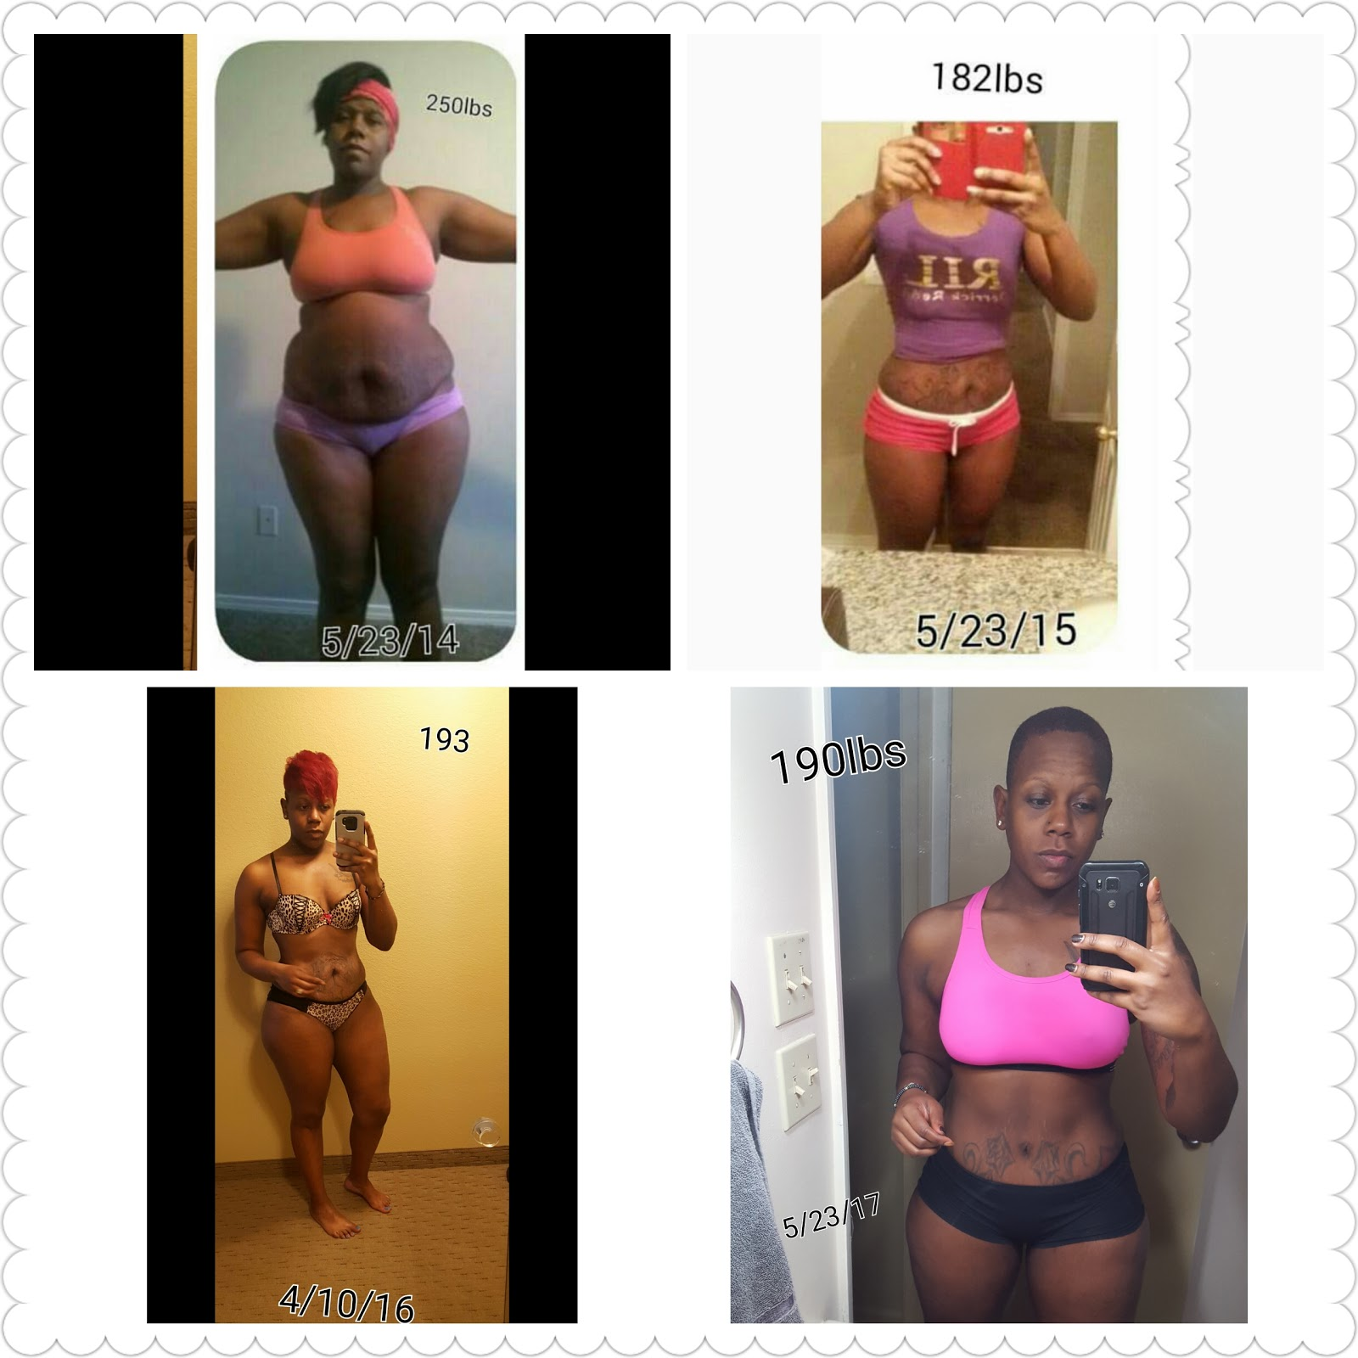
About Your Trainer
My journey started 3 years ago after I had my second child. I have always been into sports and working out, but I fell into a funk where my weight had just gotten to a point where I could not handle it. Finally, one day I decided I wanted to take back my health, my wealth, and my life. I started off slow with getting back into exercising and walking here and there, eating healthier and getting more rest. After doing more research and getting to know more about the nutrition part of things I put that with my fitness background and was able to lose the weight in a healthy way.

Slide 10
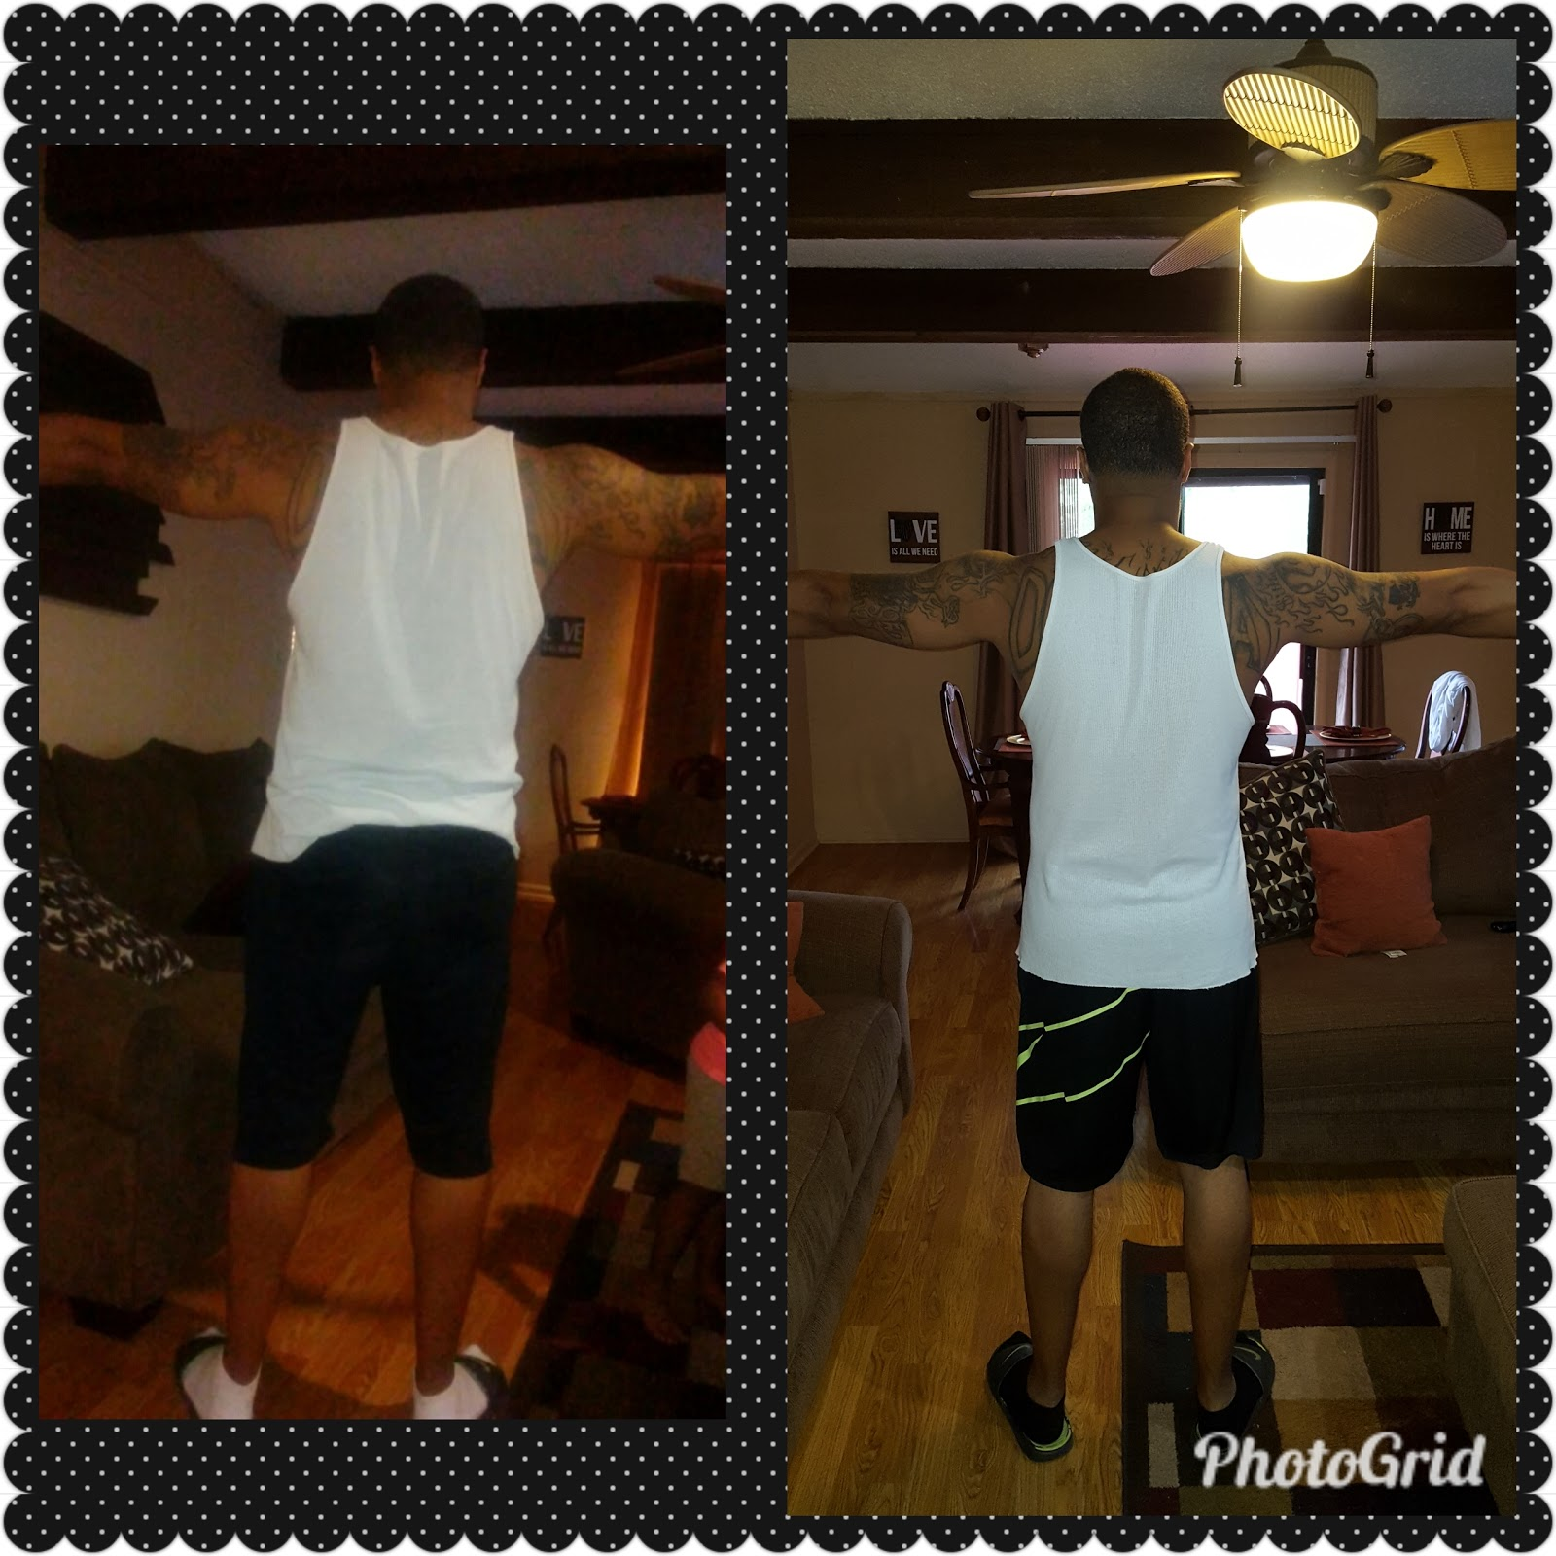
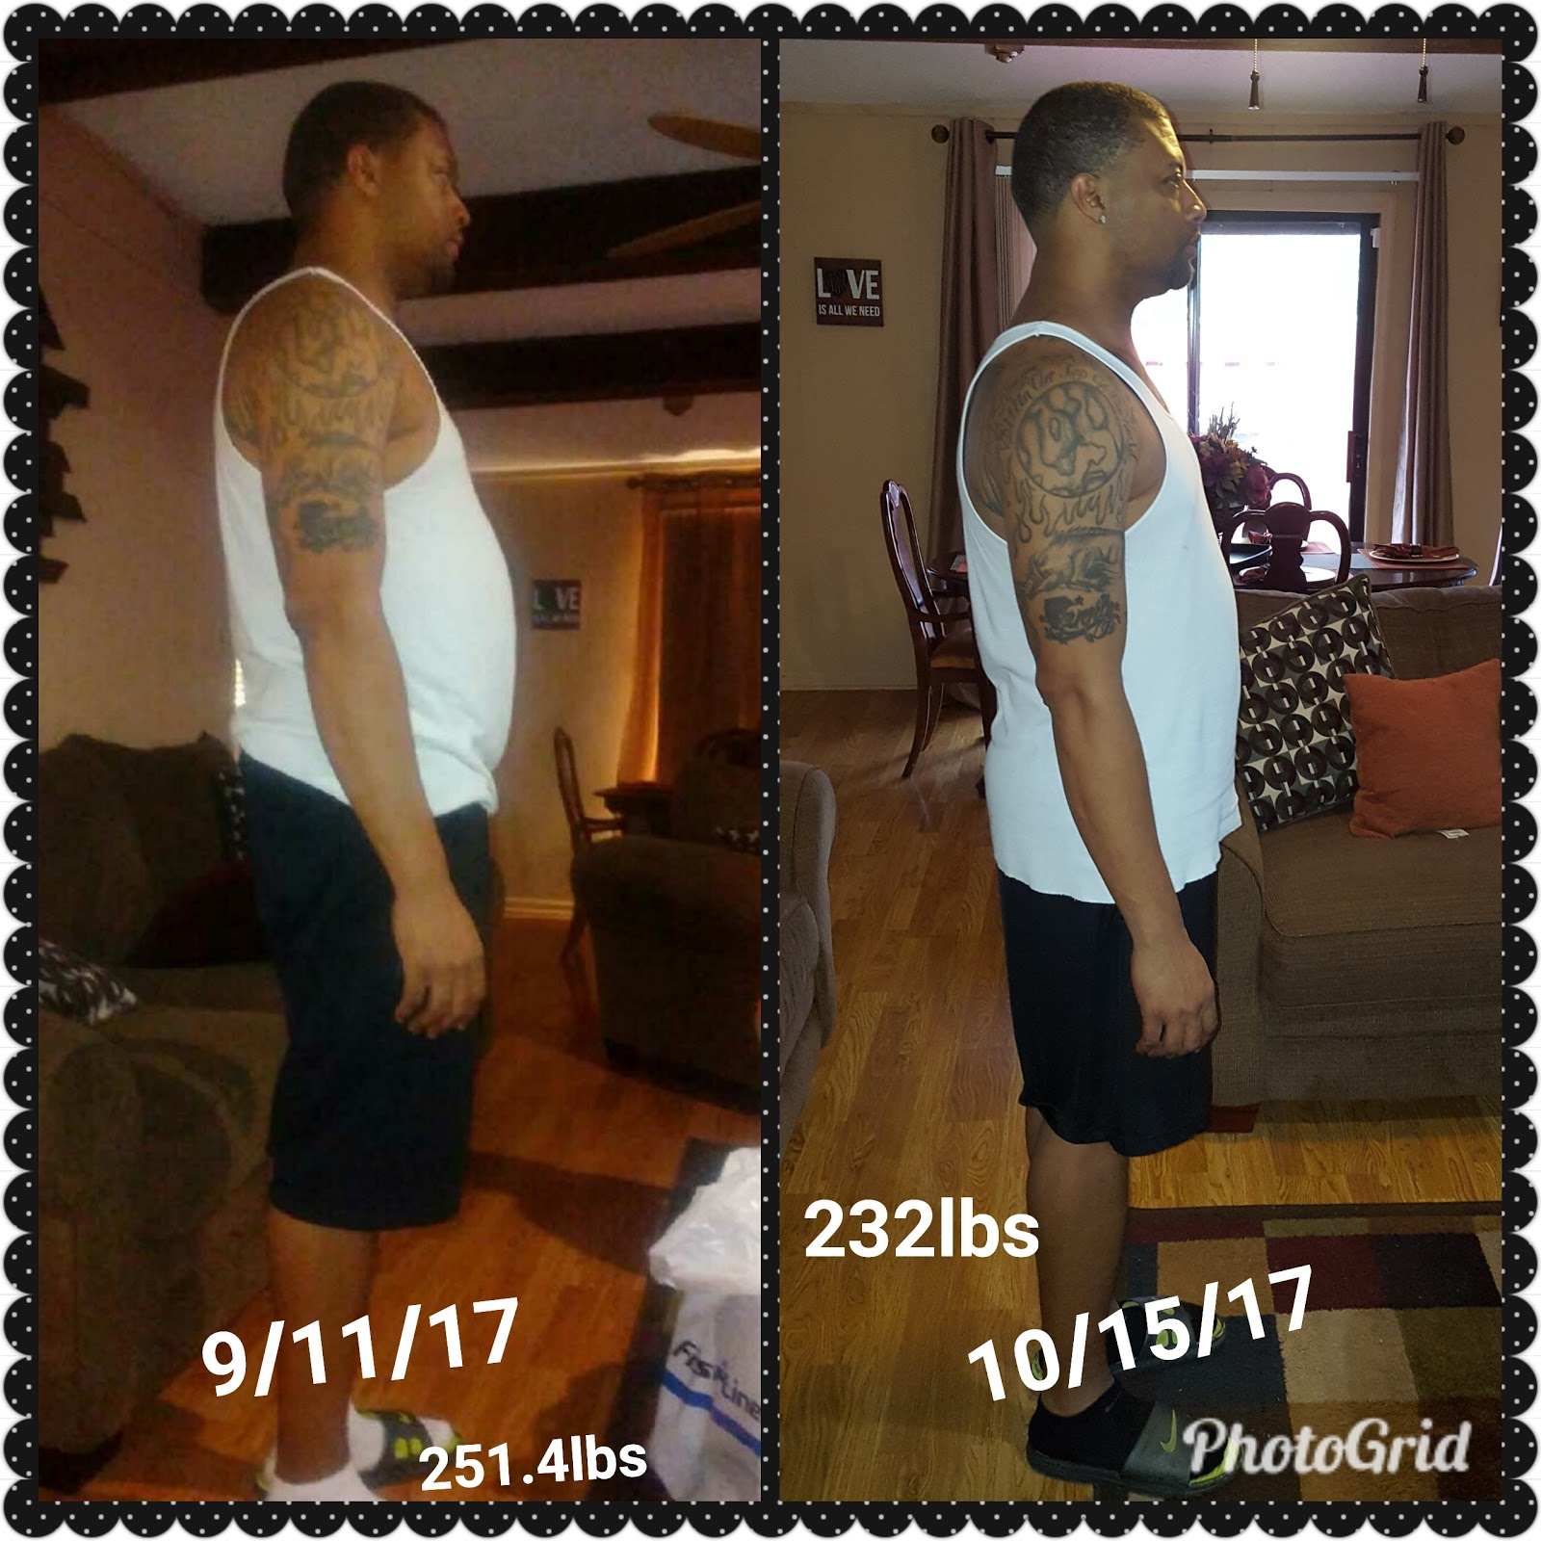
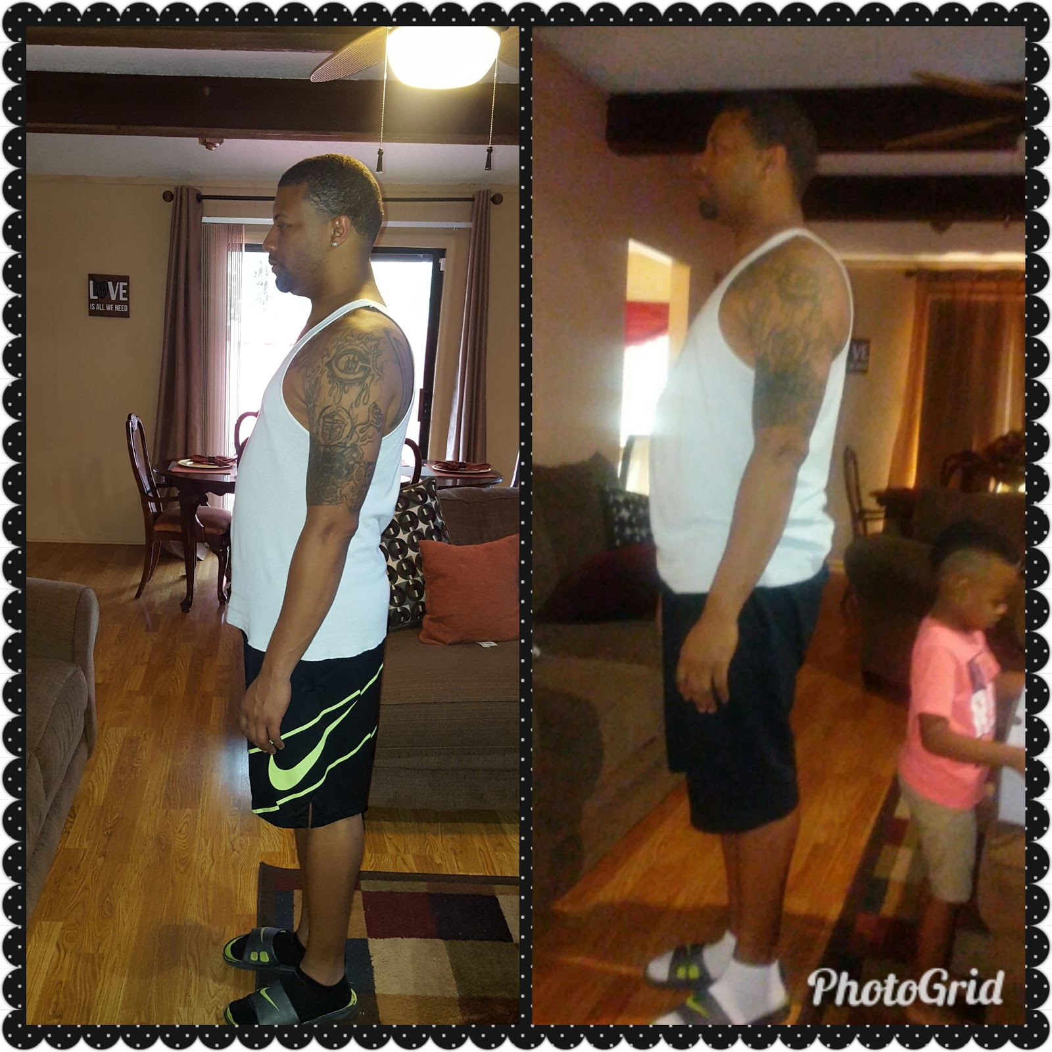
Carlos allen

Slide 11
Month-TO-MONTH
Recommended
Time Commitment
START
New Fit
Lifestyle
3 Months
6 Months
12 Months
It’s time to “Make It Happen”

Slide 12
Services and Prices
Monthly Group Session Special : $125/month (includes meal plans/meal prep is extra) for as many sessions on Monday-Friday..3pm,4pm,5pm,6pm,.Saturday session free from 7am-8am...Sundays off
Boot Camp: $15/Sessions ...sessions can be private family/friend group scheduled sessions getting prepped for an upcoming event or just wanting to get moving and started on a health journey together. Boot camps are Saturday session geared towards getting you a jumpstart on your Weekend. So join us as we motivate each other in a good sweat.
One-on-One Sessions: $35/session ...Hours are based on availability due to group sessions
Online Training: $75/month...includes meal plans, recorded exercise videos, facetime workouts, exercise plans, fitness coaching, and continuous communication as needed...
Meal Prep: $100/Week…..Includes : Breakfast/Lunch/Dinner/for 5 days

